Slide 1
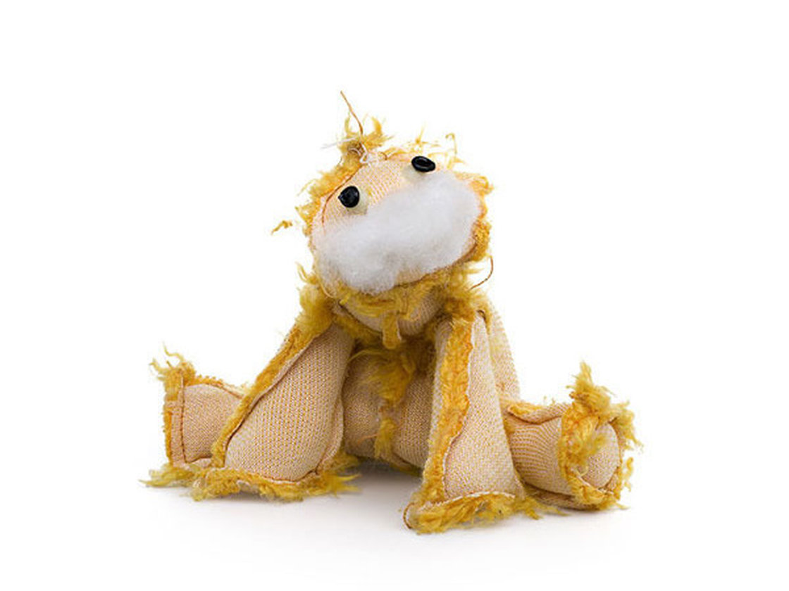
Inside Out
Inside Out
and
and
Upside
Down
Chris Jaensch

Slide 2
I’m feeling inside out,
upside down.
I’m spinning round in circles
twisting round and round.
I’m feeling really dizzy and my feet can’t touch the ground.

Slide 3
I’m feeling upside down,
inside out.
I’m losing all my confidence ,
I’m full of crazy doubt.
I’m feeling so bad
I’m ready to scream and shout.

Slide 4
Woh, woh !
What’s the matter with me?
I’m not very happy,
got the miseries.
All I know is I wanna be free
to be the me that I’m meant to be.

Slide 5
Jesus!
He’s reaching out his mighty hand.
Jesus!
He’ll set me on my feet again.
Jesus!
He’s reaching out his loving hand.
Jesus!
He’ll set me on my feet again,
set me on my feet again.

Slide 6
I’m feeling inside out,
upside down.
I’m spinning round in circles,
twisting round and round.
I’m feeling really dizzy and my feet can’t touch the ground.

Slide 7
I’m feeling upside down,
inside out.
I’m losing all my confidence ,
I’m full of crazy doubt.
I’m feeling so bad
I’m ready to scream and shout.

Slide 8
Woh, woh !
What’s the matter with me?
I’m not very happy,
got the miseries.
All I know is I wanna be free
to be the me that I’m meant to be.

Slide 9
Jesus!
He’s reaching out his mighty hand.
Jesus!
He’ll set me on my feet again.
Jesus!
He’s reaching out his loving hand.
Jesus!
He’ll set me on my feet again,
set me on my feet again.

